Slide 1
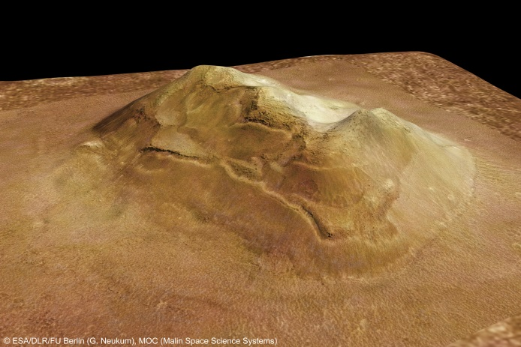
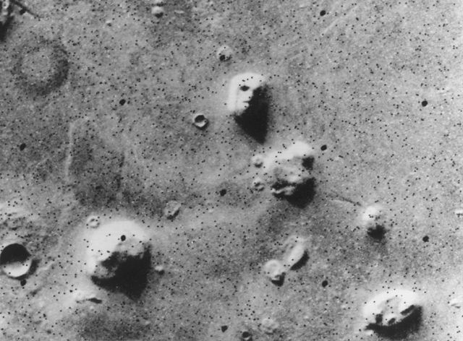
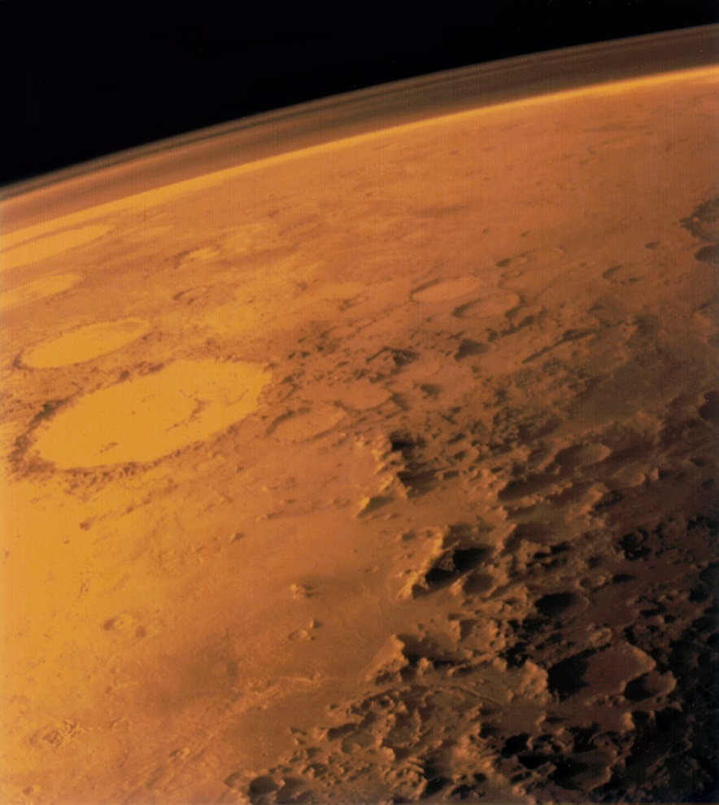
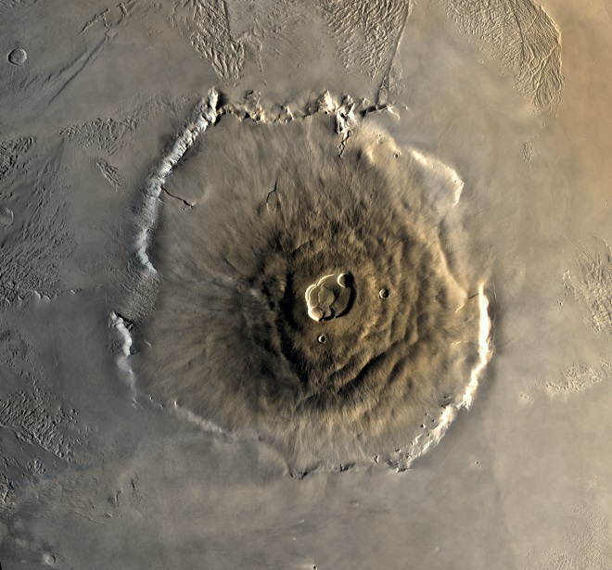
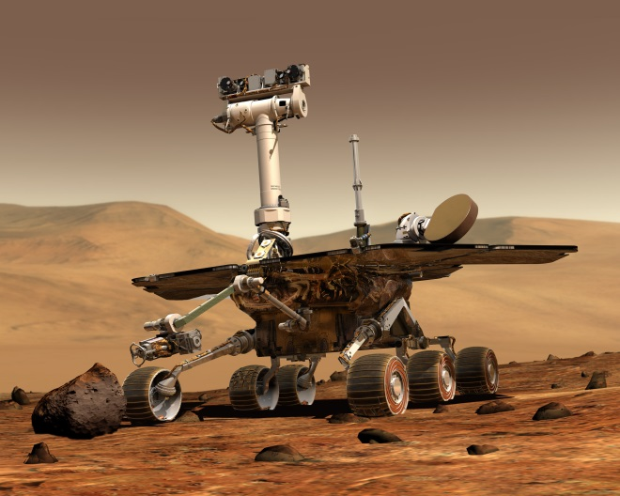
Current Research about Mars

Slide 2
Early Observations with a Telescope
Galileo Galilei (1609) – First known telescopic observation of Mars
Johannes Kepler (1609) – uses Tycho Brahae’s naked eye observations to determine that Mars’ orbit is elliptical.
Detail in smaller telescopes isn’t great, but astronomers over the next 3 centuries were able to determine that Mars :
has polar ice caps,
rotates on an inclined axis at a rate of 24 hours 37 min 22.7 sec, and
has two moons: Phobos (Fear) and Deimos (Panic).
They even speculated about life on Mars…

Slide 3
American astronomer, Percival Lowell uses his observatory near Flagstaff, AZ to observe Mars in the 1890s.
Convinces himself that he sees an immense network of straight lines on Mars, and hypothesizes that they are artificial canals built by an advanced Martian civilization.
Some others also claim to observe these lines. But many others do not.
The lines were eventually shown to not be there.

Slide 4
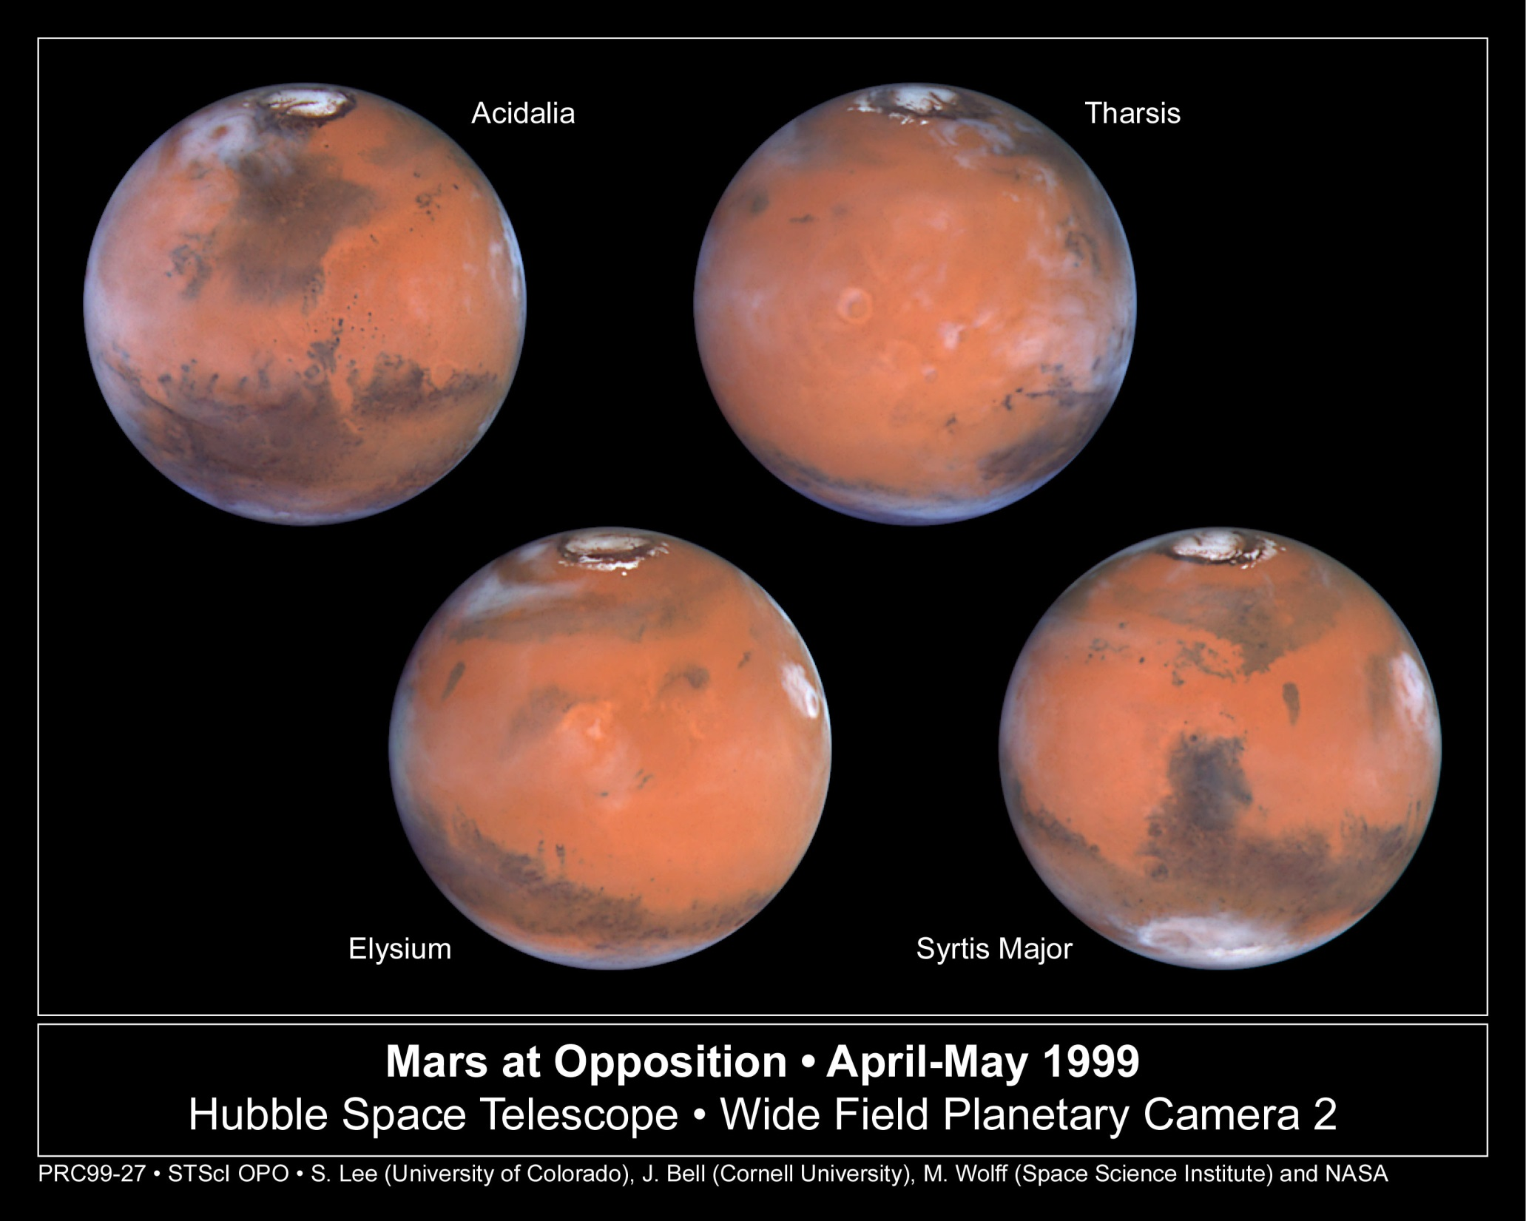

Slide 5
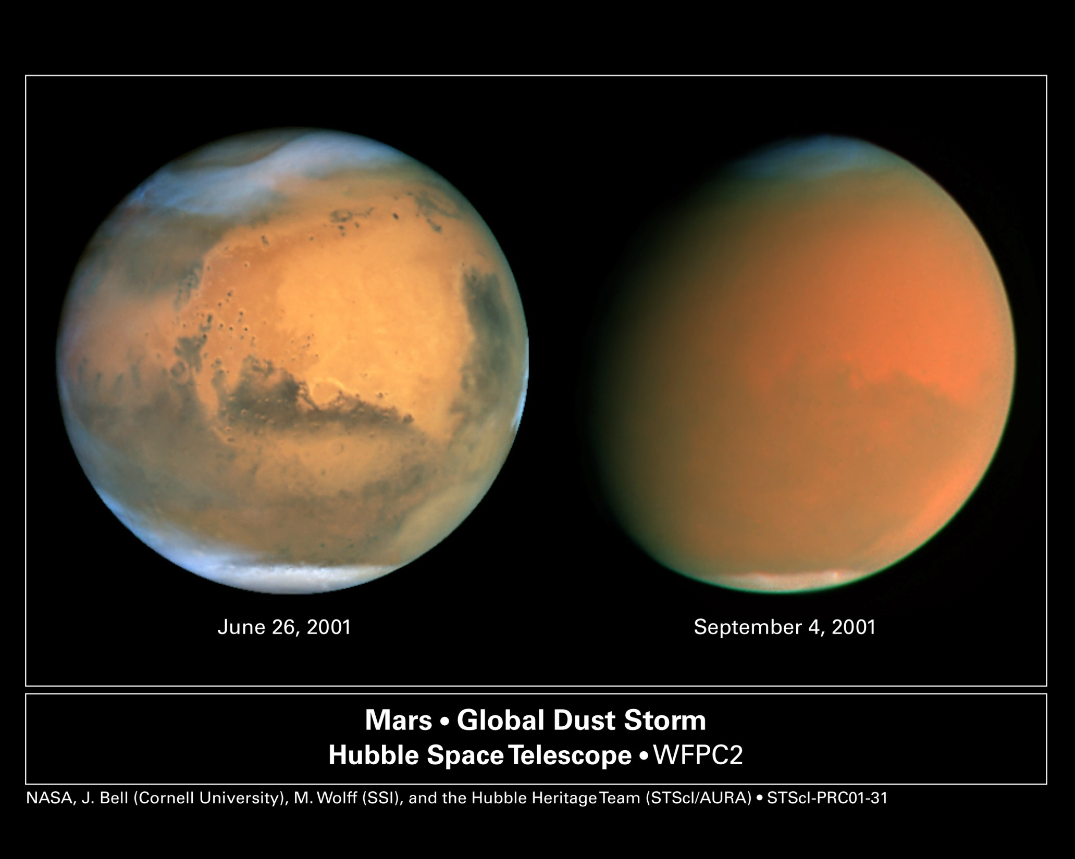

Slide 6
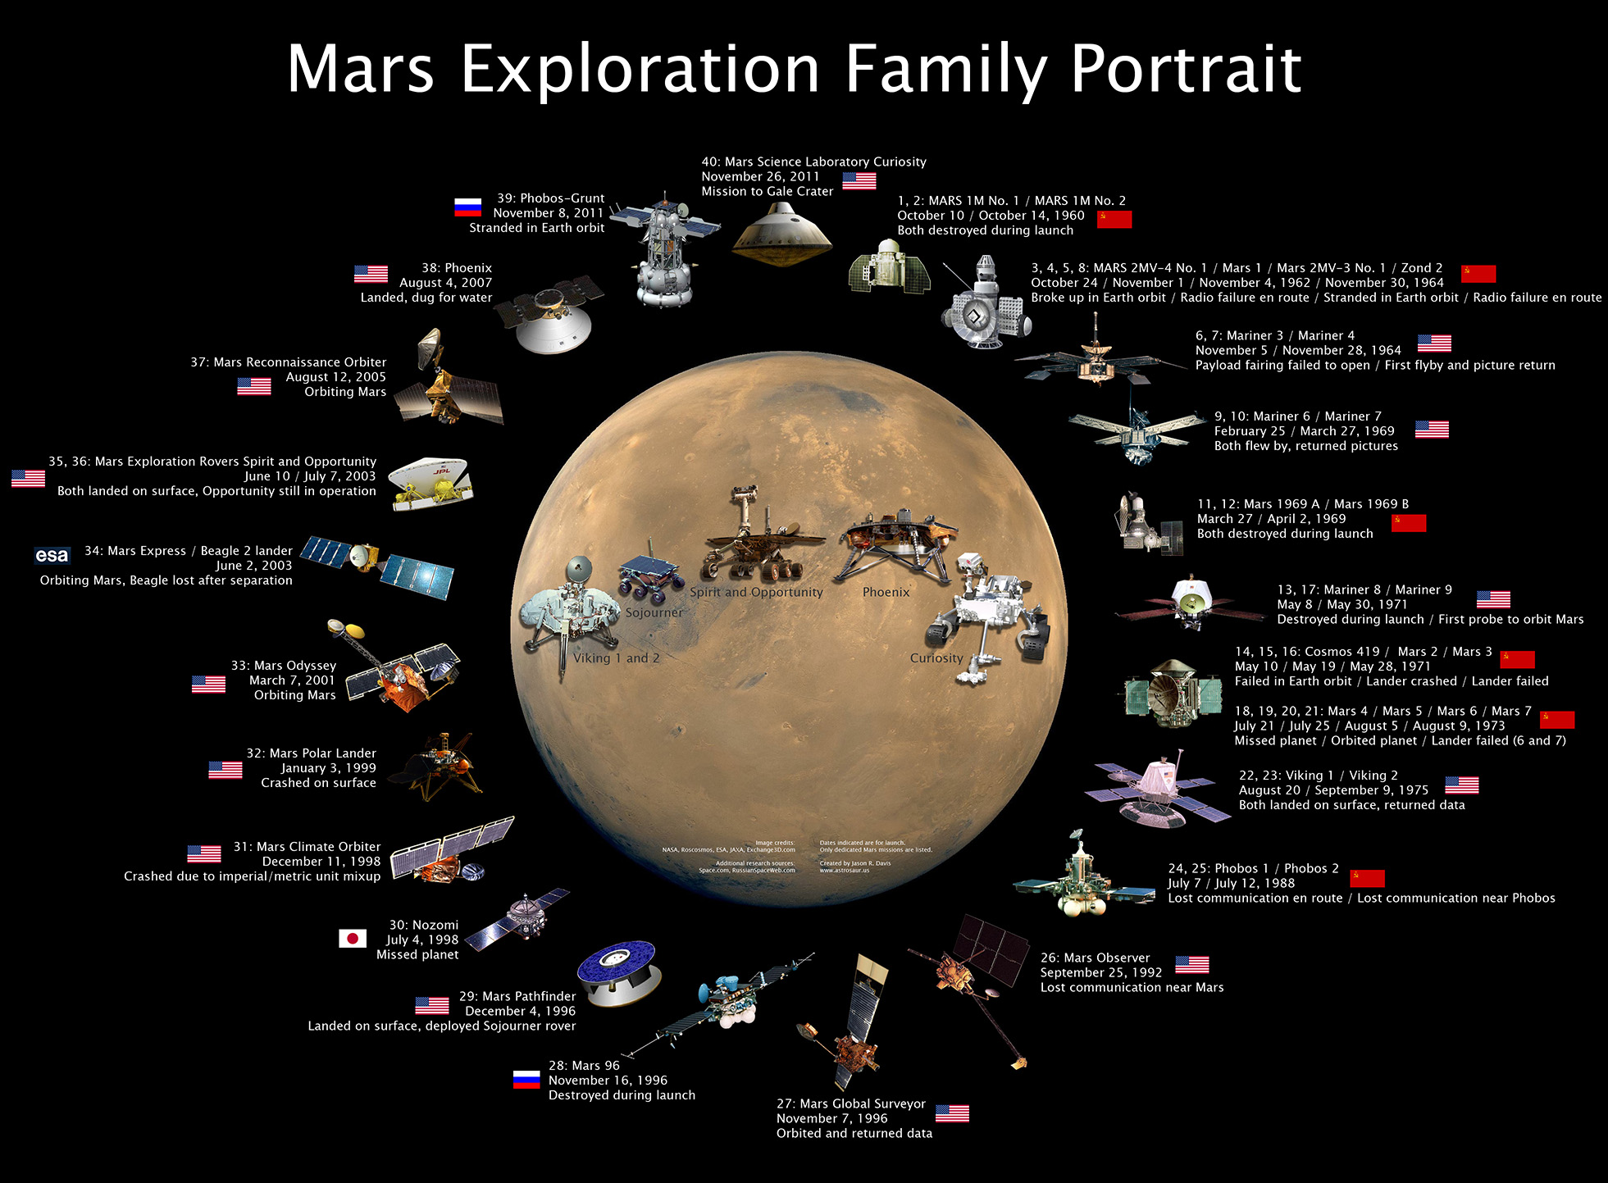
2013: MAVEN (USA), Mars Orbiter Mission (India)

Slide 7
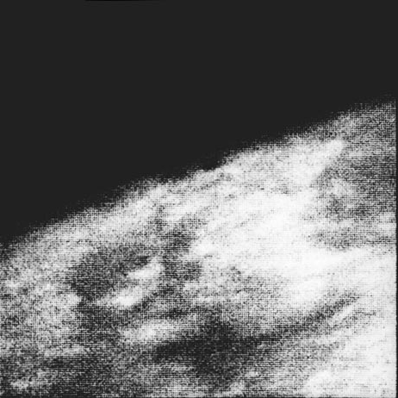
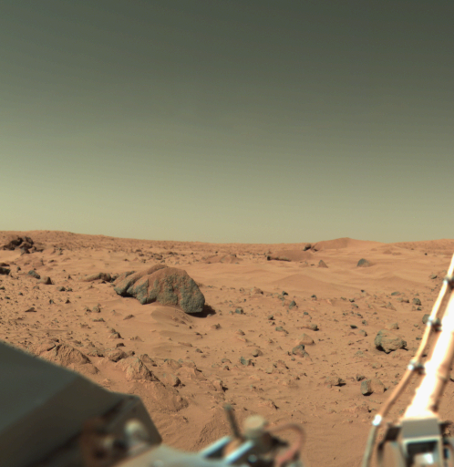
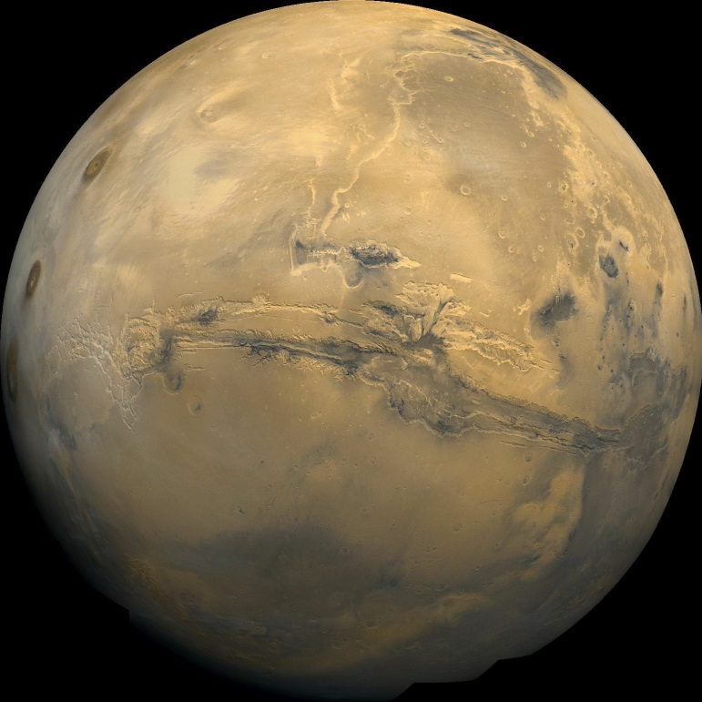
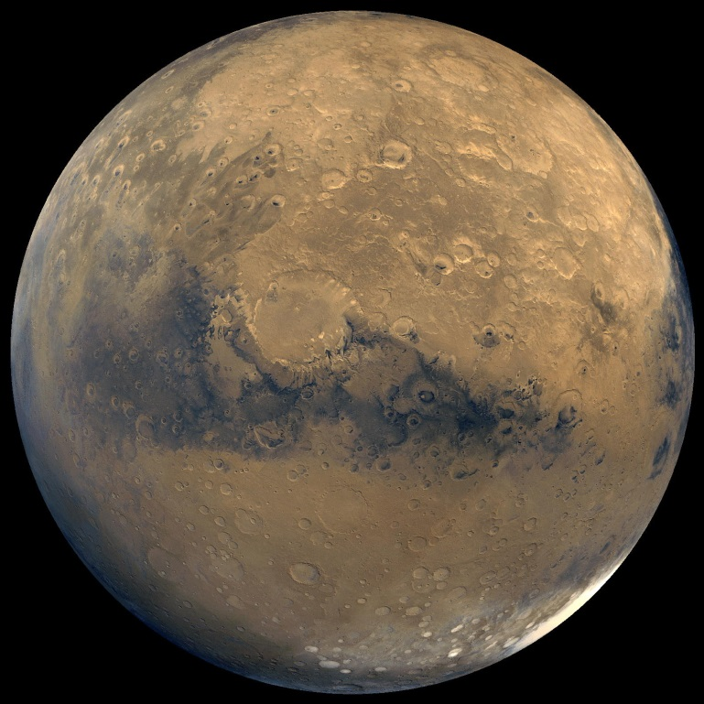
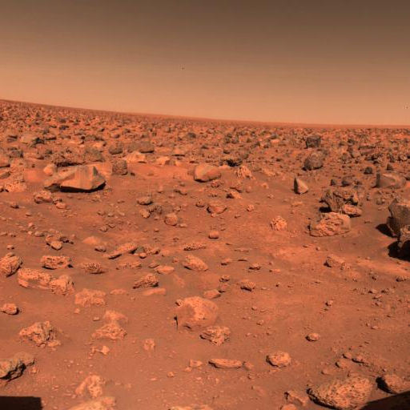
1960s – Mariner Flybys
1970s – Viking Landers
1970s – Viking Orbiters

Slide 8
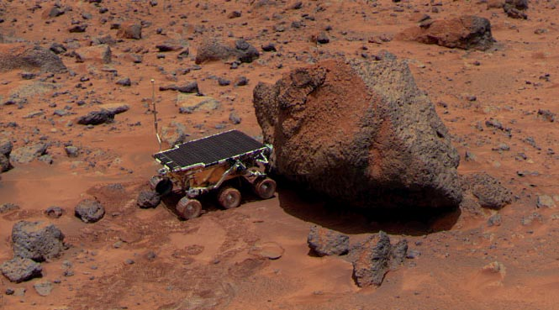
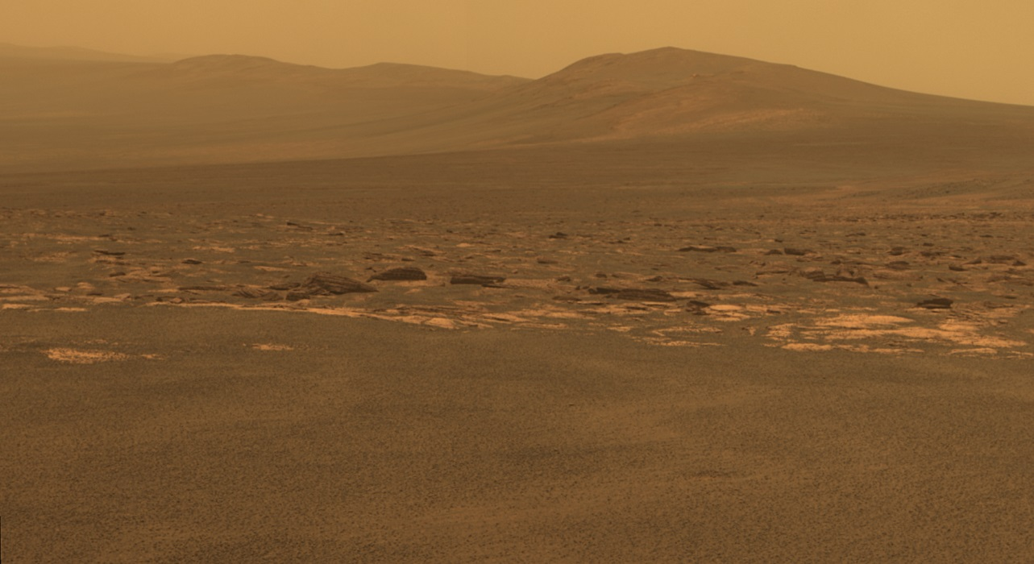
1990s – Present: Landers and Rovers
Revealing a dry, cold, and lifeless surface

Slide 15
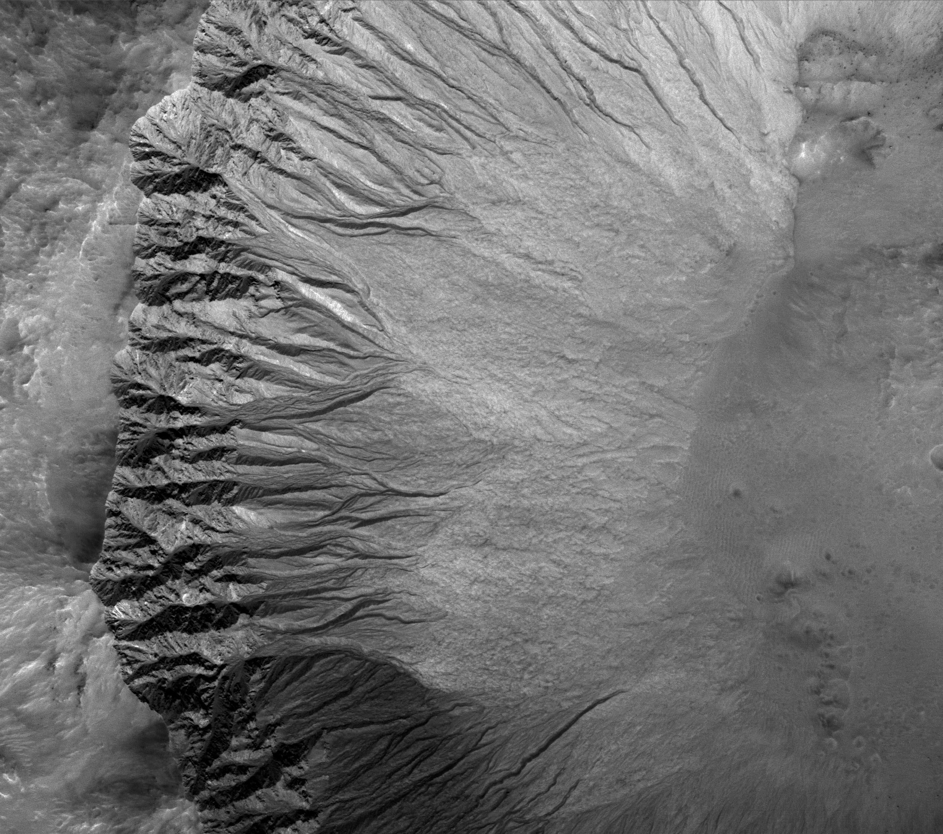
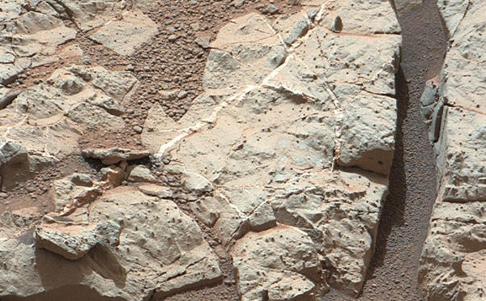
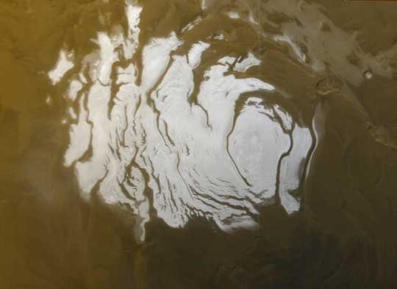
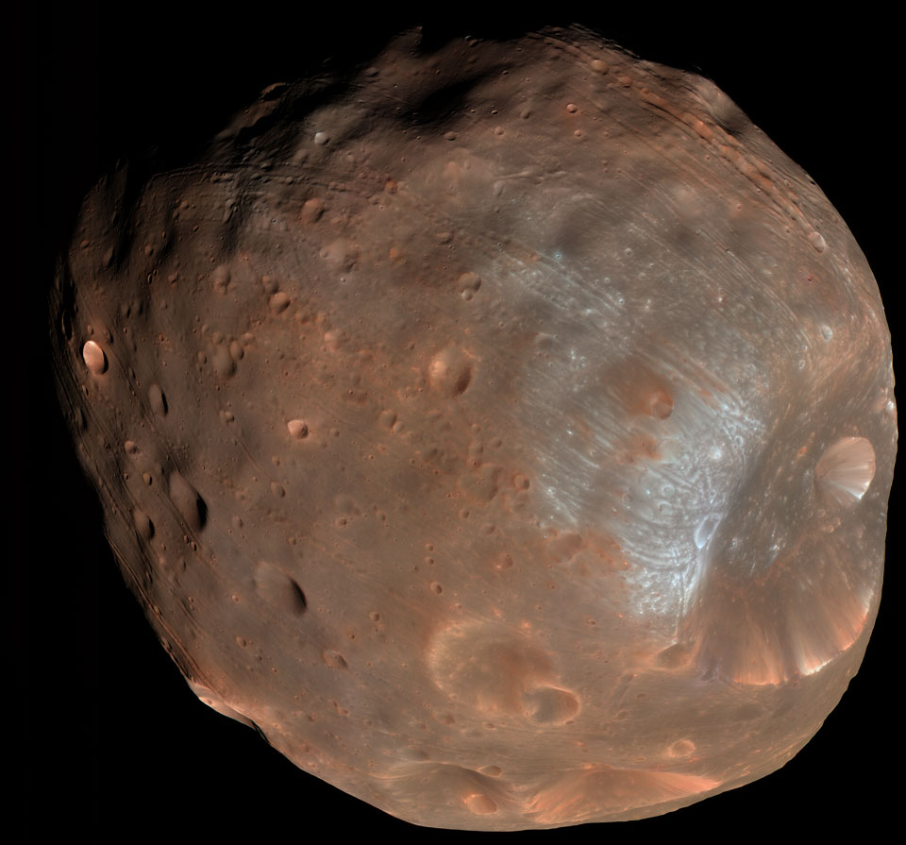
Minerals and Features that testify to the chemical action of ancient Liquid Water.
Possible Recent Flows of Liquid Water
Water and Carbon Dioxide Ice at poles and under the surface
Phobos: Likely a Captured Asteroid

Slide 16
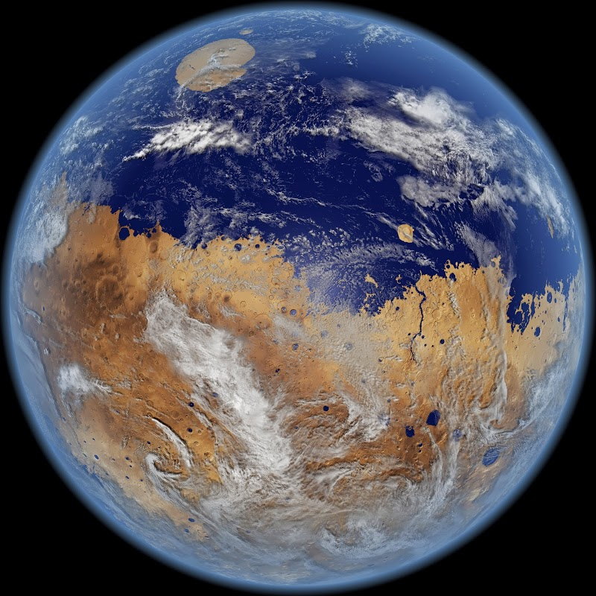
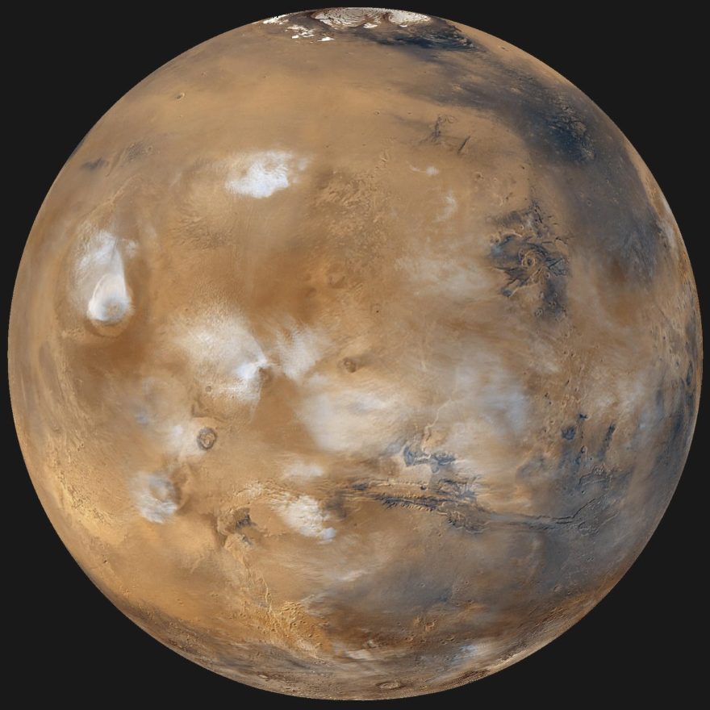
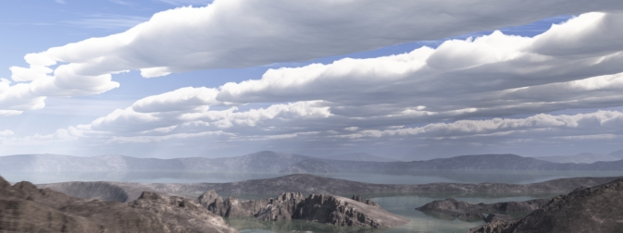
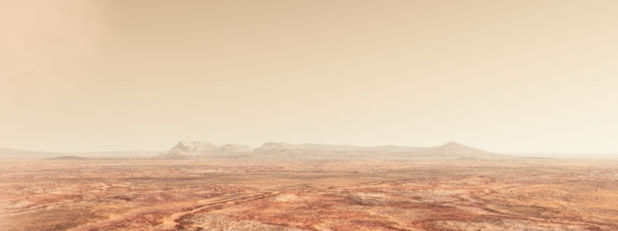
What Happened to Mars’ Atmosphere and Water?
Ancient Mars
Current Mars
Was there ancient life on Mars? If so, did it manage to survive underground?

Slide 17
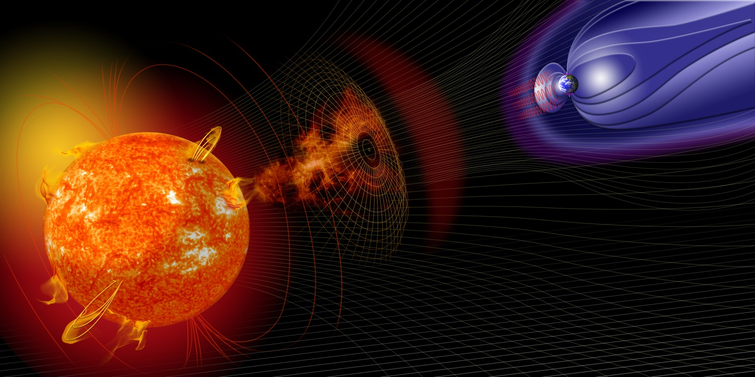
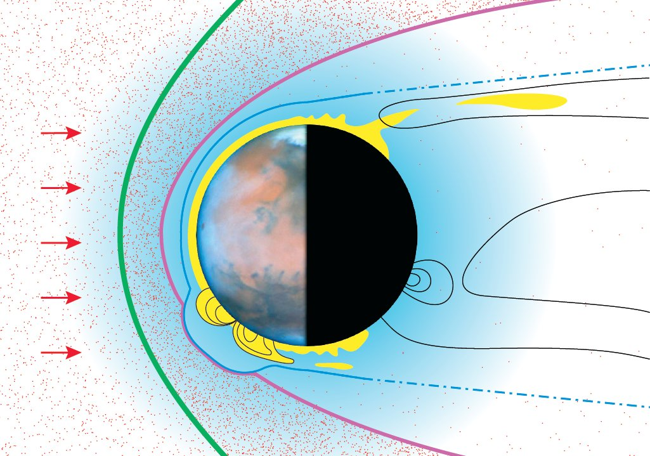
Earth has a global magnetic field that protects it from solar particle streams
Mars has only local magnetic fields frozen into the planet’s crust.
This crustal magnetic field is probably the fossil of an ancient global magnetic field that went away, leaving the atmosphere to be stripped away and the surface vulnerable to solar radiation (light and particles).

Slide 18
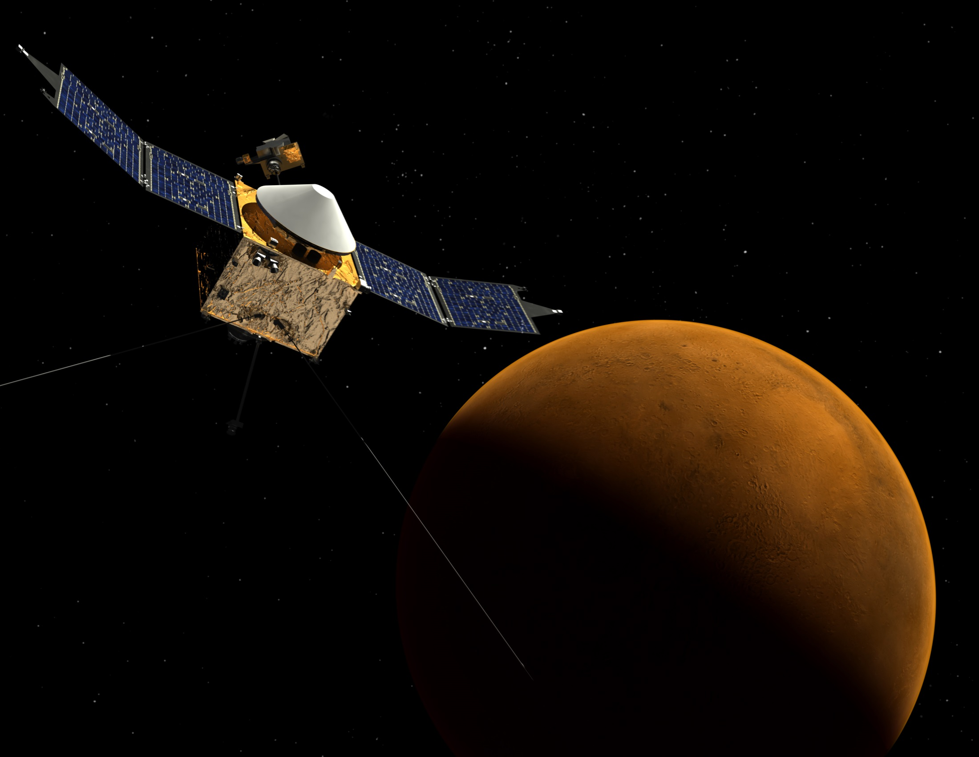
MAVEN seeks to understand how the Martian atmosphere is lost to space and what happened to Mars’ water.

