Slide 1
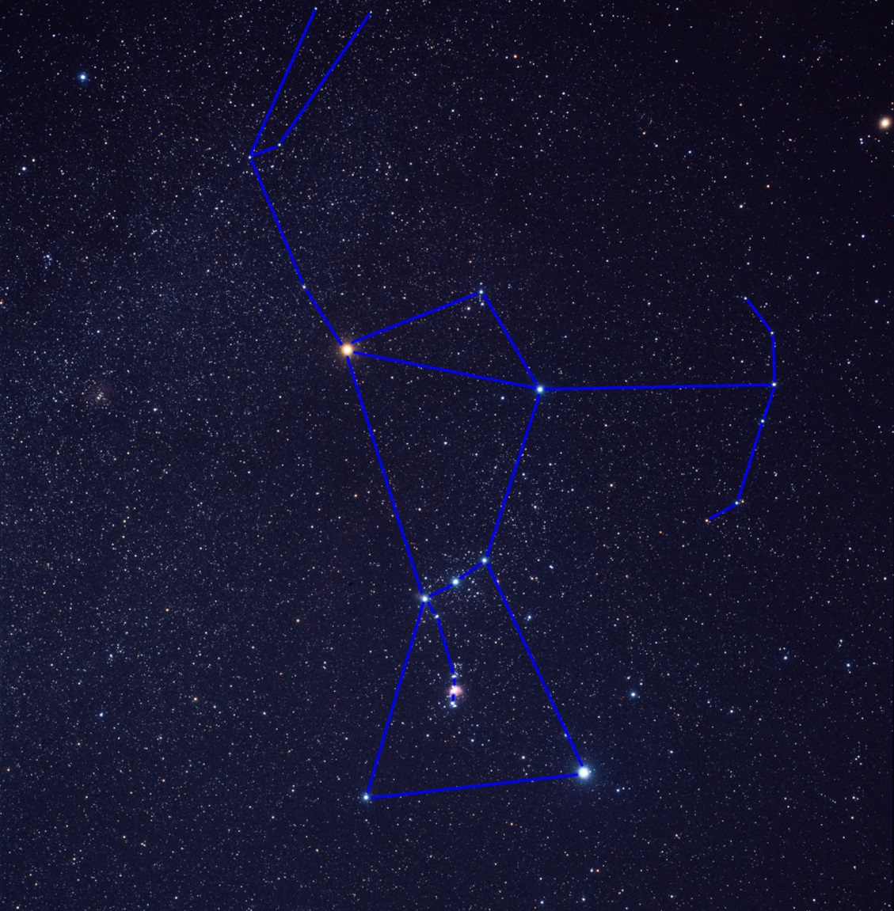
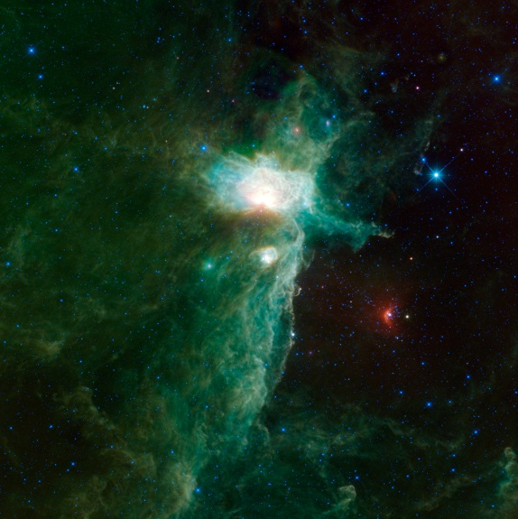
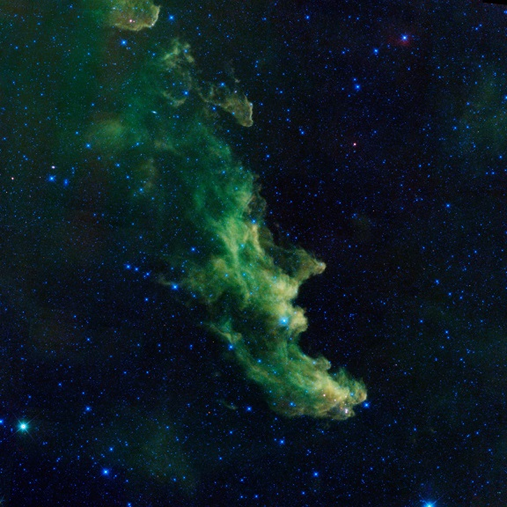
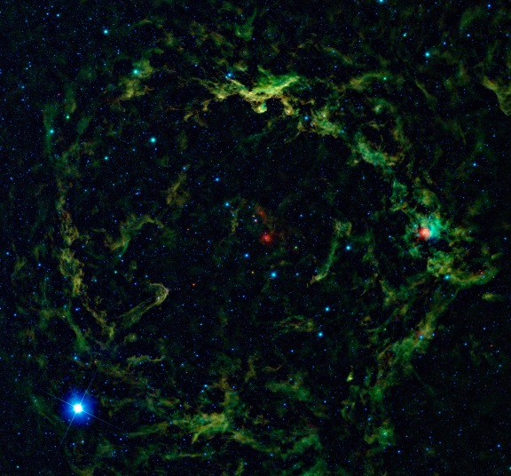
Current Research: Orion and the Pleiades
Notes:
Image Credits (right to left, top to bottom): Akira Fujii, NASA/IPAC/WISE x 3, NASA/STScI/HST

Slide 2
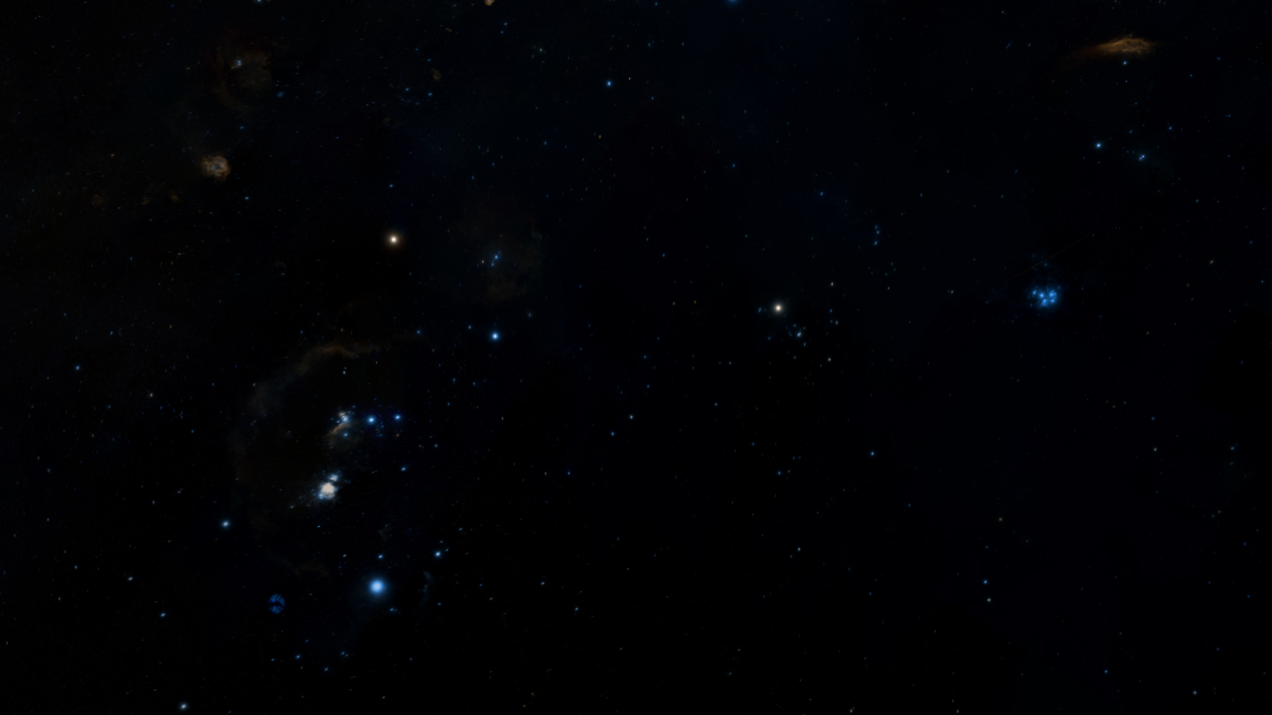
Notes:
Image Credit: Digitized Sky Survey & World Wide Telescope

Slide 3
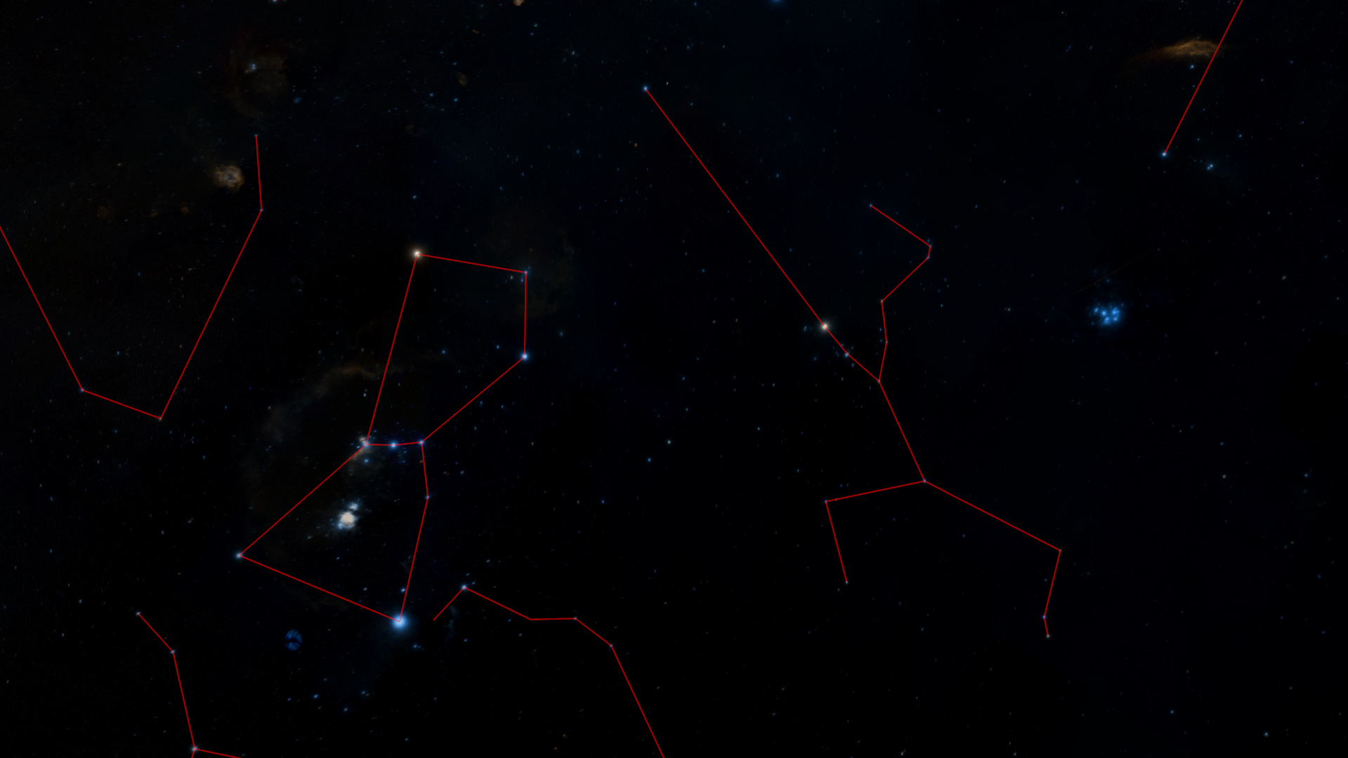
Orion
Taurus
Notes:
Image Credit: Digitized Sky Survey & World Wide Telescope

Slide 4
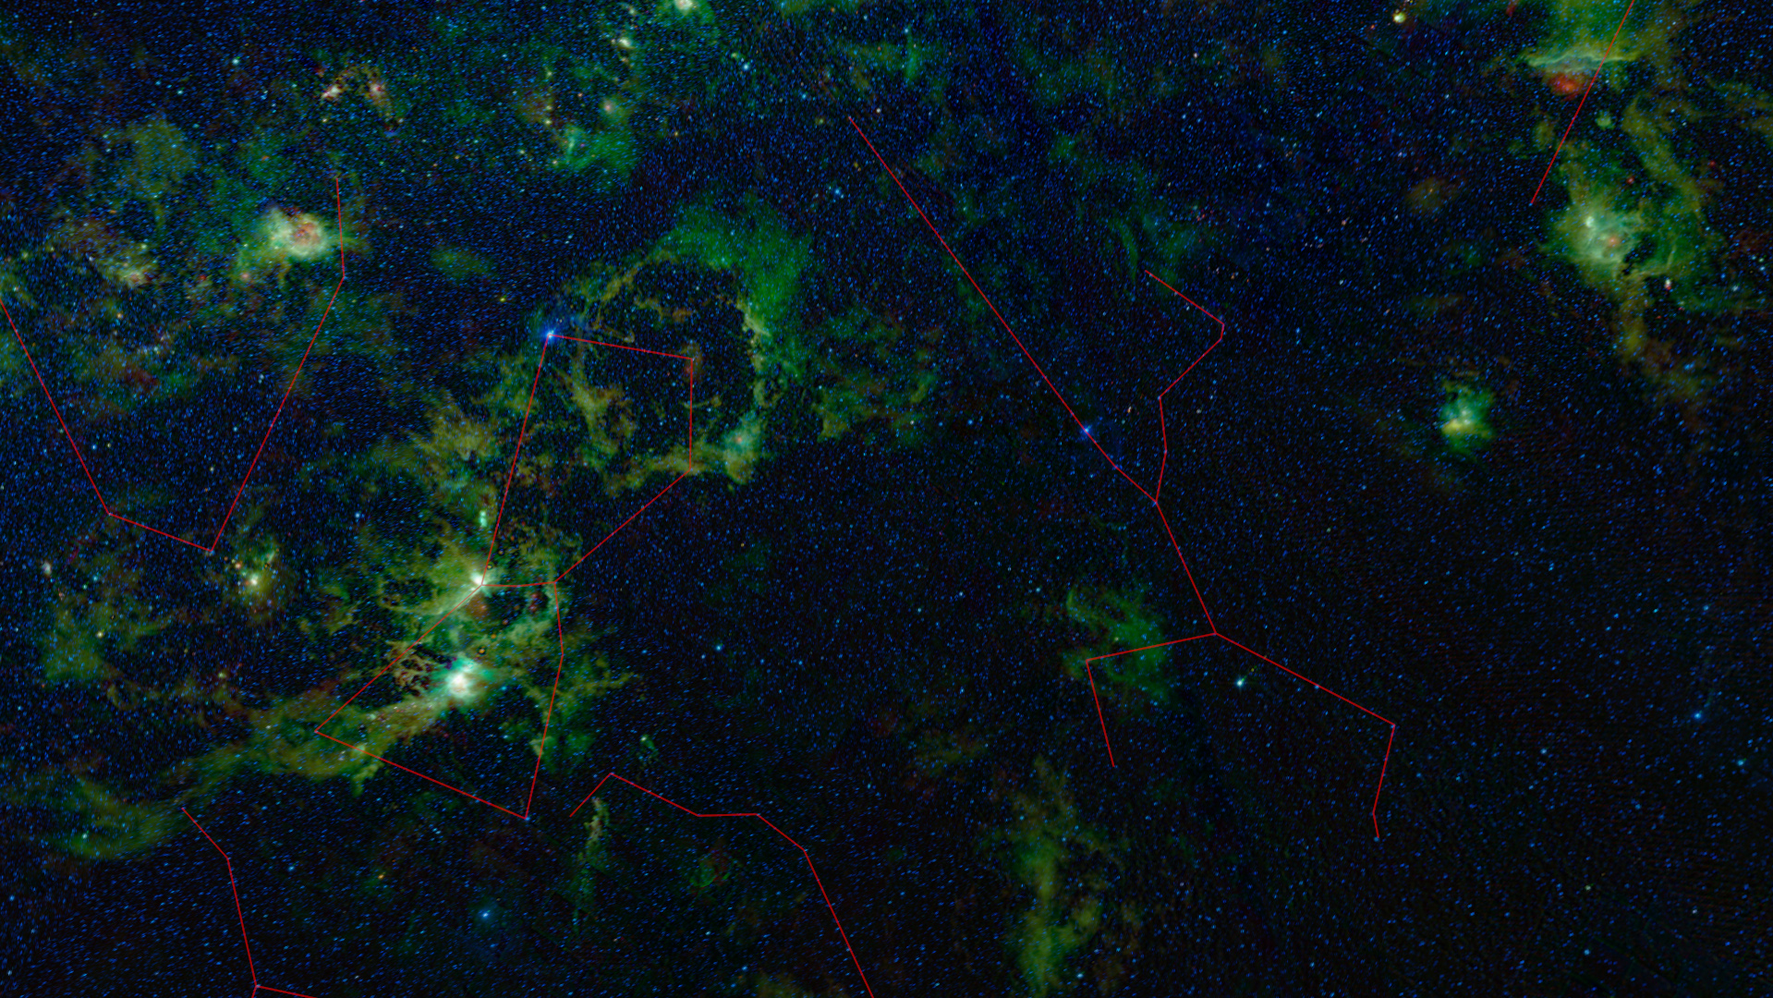
Notes:
Image Credit: NASA/IPAC/WISE & World Wide Telescope

Slide 5
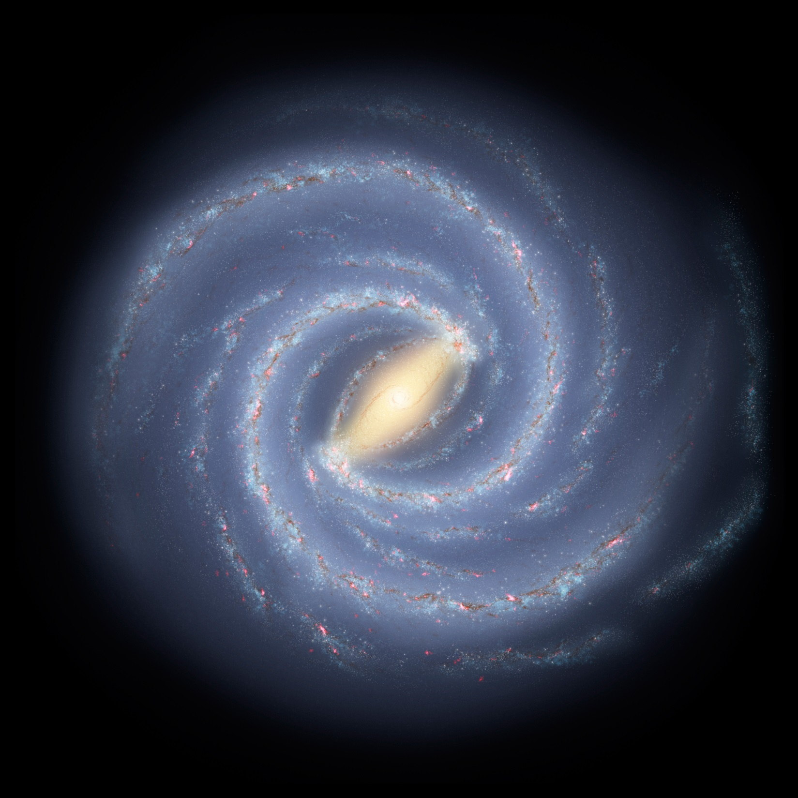
Notes:
Image Credit: Caltech/Spitzer Science Center

Slide 6
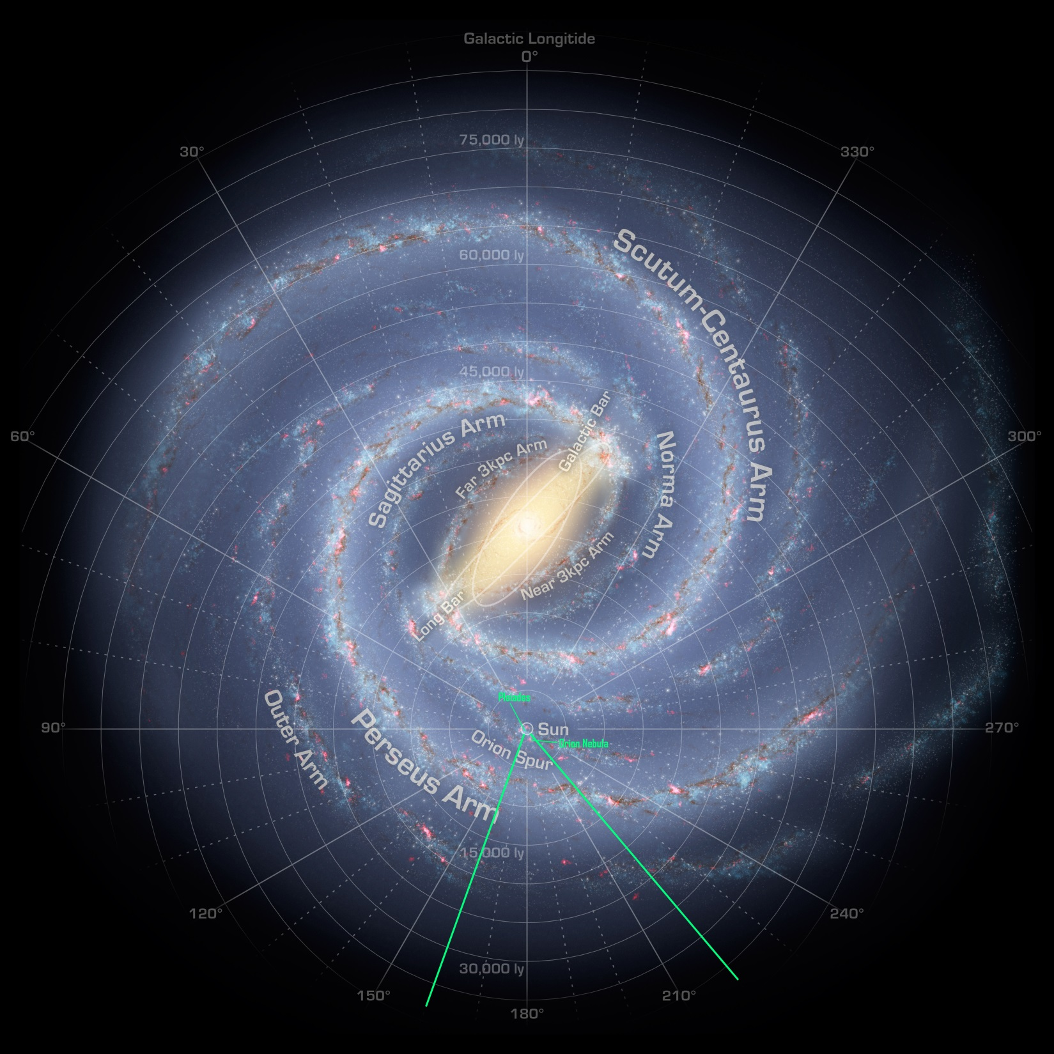
Notes:
Image Credit: Caltech/Spitzer Science Center

Slide 7
Notes:
The Orion Nebula is the farthest object in the constellations of Orion and Taurus. All the bright stars in these constellations are closer than 1,500 Light-years.
Image Credit: Caltech/Spitzer Science Center

Slide 8
Orion Nebula
Notes:
Image Credit: NASA/IPAC/WISE & World Wide Telescope

Slide 9
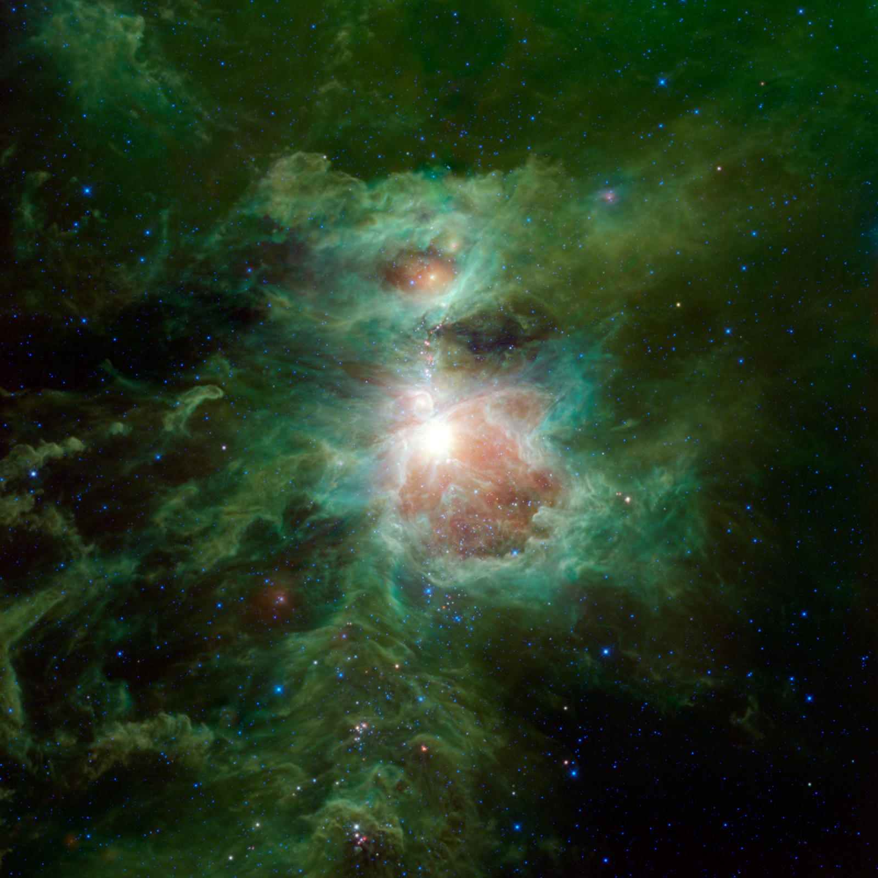
Notes:
Image Credit: NASA/IPAC/WISE

Slide 10
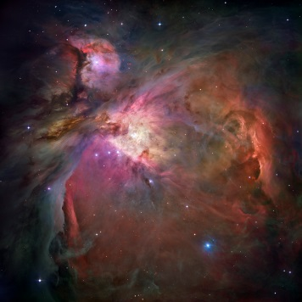
Notes:
Image Credit: NASA/IPAC/WISE

Slide 11
Notes:
Image Credit: NASA/STScI/HST

Slide 12
Notes:
Image Credit: NASA/STScI/HST

Slide 13
Notes:
Image Credit: Caltech/Spitzer Science Center

Slide 14
Notes:
Image Credit: Caltech/Spitzer Science Center

Slide 15
Notes:
Image Credit: Caltech/Spitzer Science Center

Slide 16
HH-34
Notes:
Image Credit: NASA/IPAC/WISE & World Wide Telescope

Slide 17
Notes:
Image Credit: Caltech/Spitzer Science Center

Slide 18
Pleiades
Notes:
Image Credit: NASA/IPAC/WISE & World Wide Telescope

Slide 19
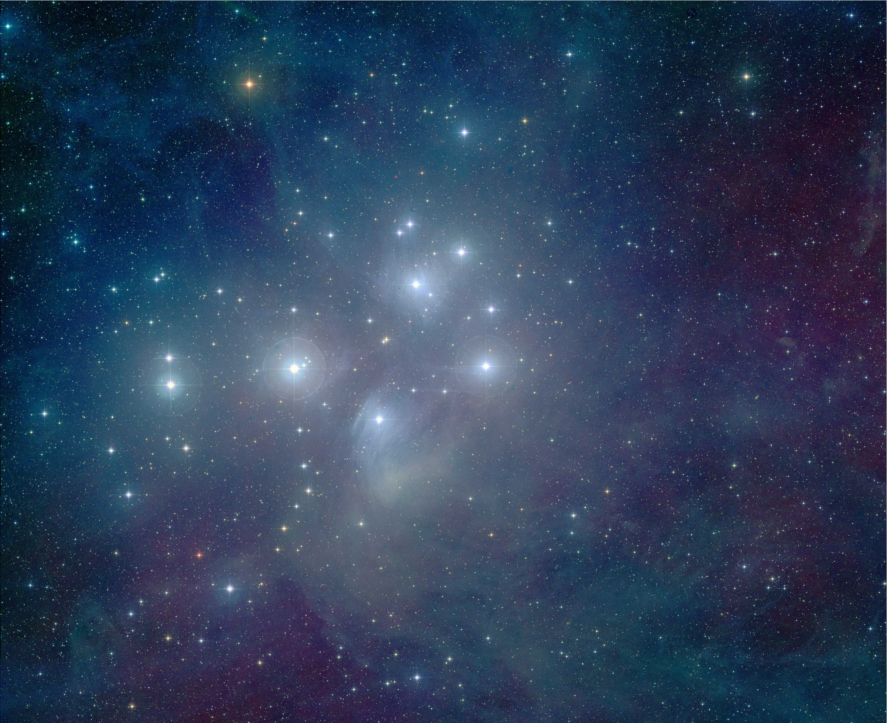
Notes:
Open Cluster
436 light-years from Earth
~100 million years old
It may seem really old to you and me, but the Sun, Earth, and Solar System are 5 billion years old. That’s 50 times older. The Pleiades are cosmic youngsters compared to the Solar System.
The cluster will dissipate after a few hundred million years
There are over 100 stars in the cluster, most of which are in a stable state of equilibrium between the crush of gravity from their own weight and the outward pressure generated by the stable fusion of hydrogen in their cores.
This is where stars spend the vast majority of their lives. Stars like the Sun spend around 10 billion years in this stage of life, while their birth and death phases occupy a few million years at most.
More massive stars progress more quickly, and lower mass stars progress more slowly. But in both cases a similar proportion of their lives is spent in equilibrium, burning hydrogen fuel in their cores.
The brightest stars in the Pleiades have exhausted their hydrogen fuel and have evolved into their last stages of life, and will live for several million years more hereafter but changing size and temperature frquently.

Slide 20
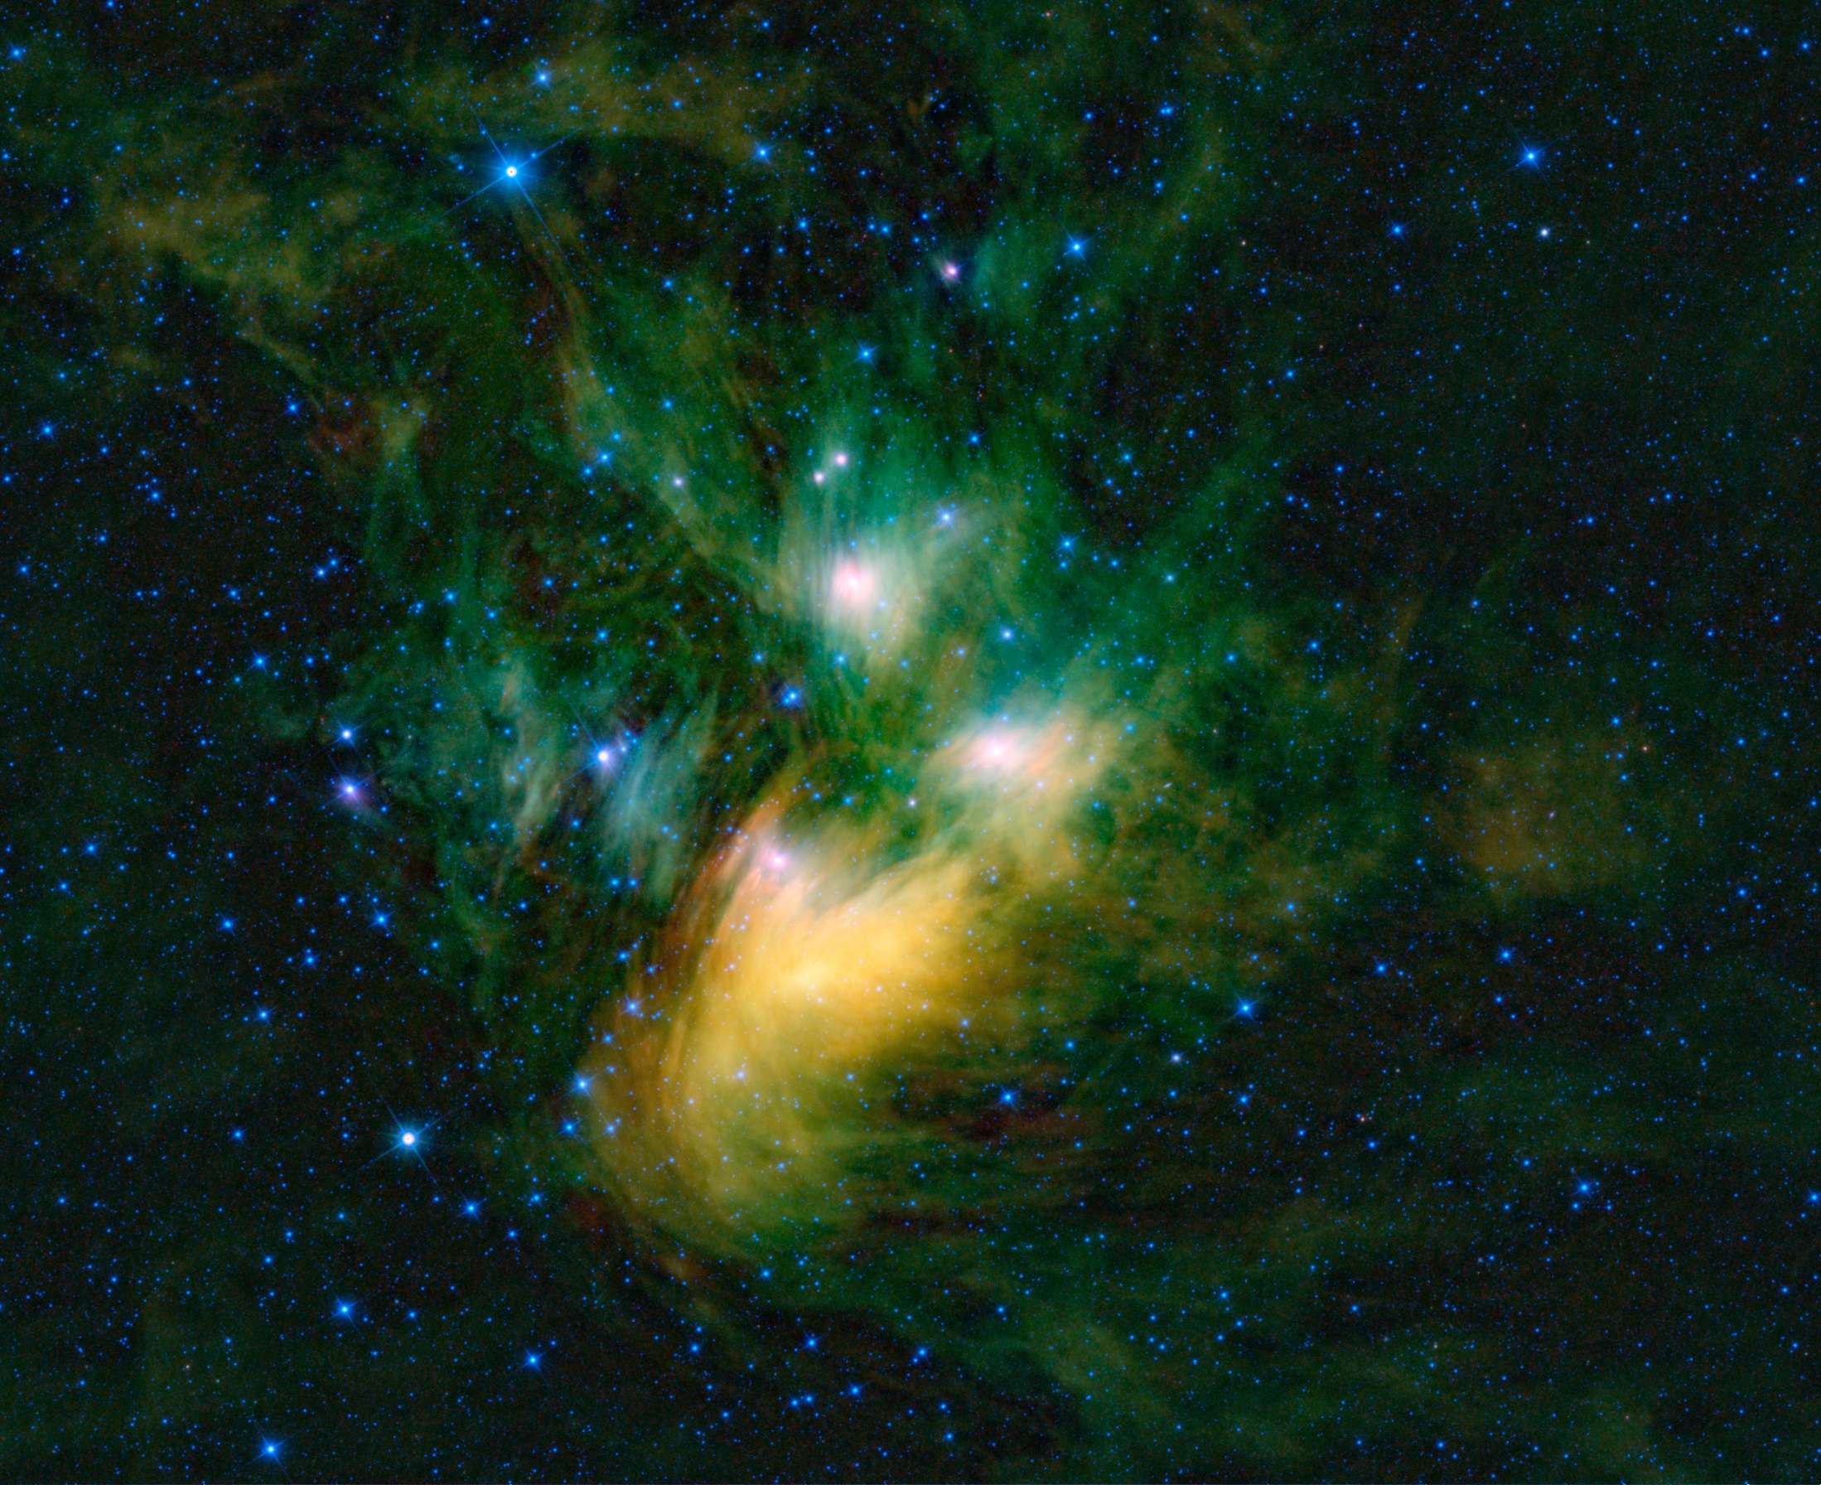
Notes:
The clouds of dust and gas surrounding it are probably a nebula that the cluster has recently entered and is simply moving through. The dust and gas are not associated with the cluster stars themselves.
Image Credit: NASA/IPAC/WISE

Slide 21
Betelgeuse
Meissa
Aldebaran
Bellatrix
Alnilam
Alnitak
Mintaka
Saiph
Rigel
Notes:
All the bright stars in Orion and Taurus are giant stars that have exhausted the hydrogen fuel in their cores and bloat up in size as they fight to stay alive and begin fusing heavier elements in their cores.
None of these stars will be here in a few million years. Most will go via supernova
Image Credit: Digitized Sky Survey & World Wide Telescope

Slide 22
Sun
Bellatrix
Meissa A
Betelgeuse
Mintaka A
Alnilam
Alnitak A
Aldebaran
Saiph
Rigel A
Notes:
The relative sizes of the bright stars in these constellations compared to the Sun.

Slide 23
NGC 1514
Notes:
Image Credit: NASA/IPAC/WISE & World Wide Telescope

Slide 24
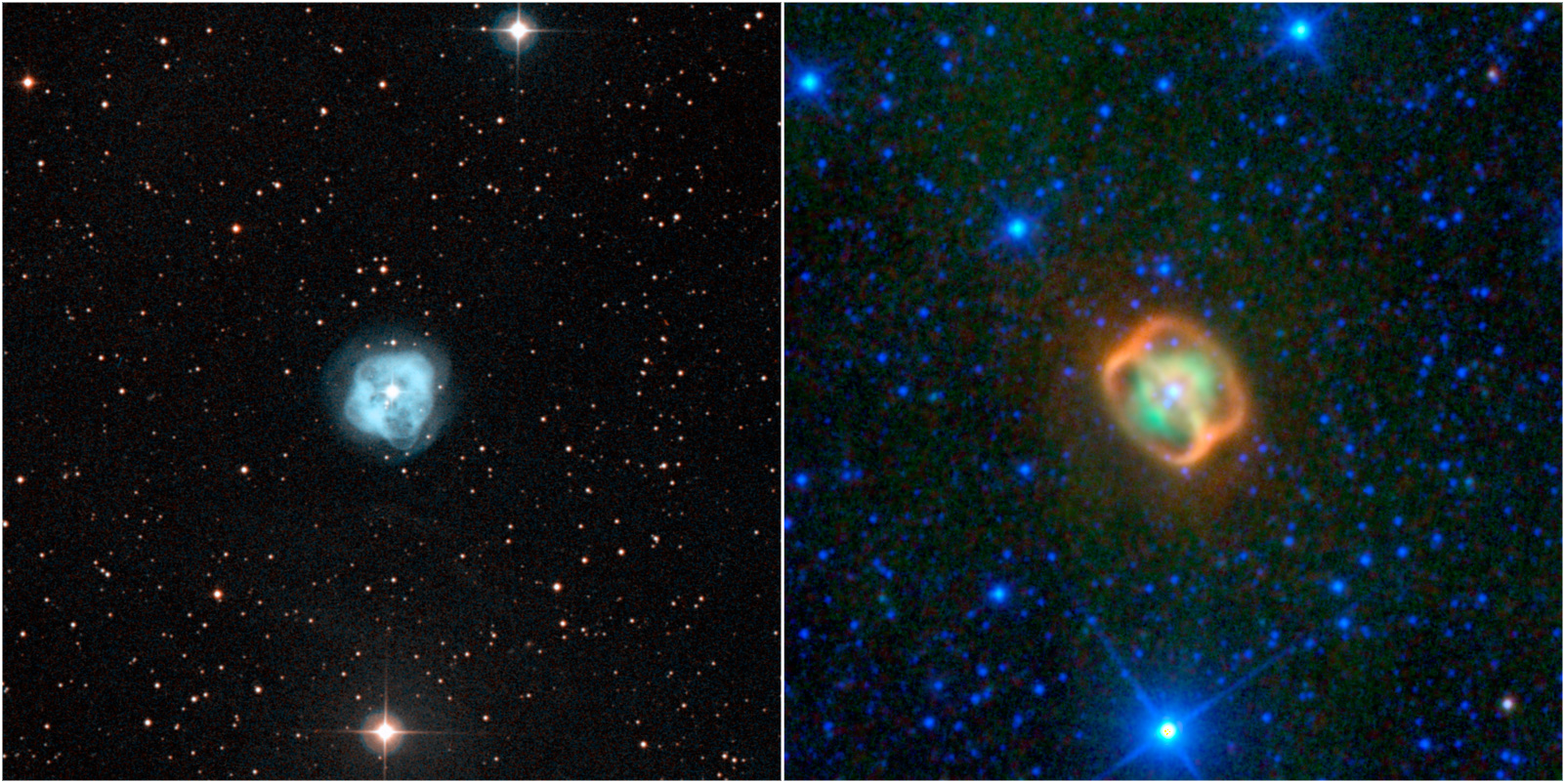
Notes:
This image composite shows two views of a puffy, dying star, or planetary nebula, known as NGC 1514. The view on the left is from a ground-based, visible-light telescope; the view on the right shows the object in infrared light, as seen by NASA's Wide-field Infrared Survey Explorer, or WISE.
The object is actually a pair of stars -- one star is a dying giant somewhat heavier and hotter than our sun, and the other was an even larger star that has now contracted into a dense body called a white dwarf. As the giant star ages, it sheds some its outer layers of material to form a large bubble around the two stars. Jets of material from the white dwarf are thought to have smashed into this bubble wall. The areas where the jets hit the cavity walls appear as orange rings in the WISE image. This is because dust in the rings is being heated and glows with infrared light that WISE detects.
The green cloud seen in the WISE view is an inner shell of previously shed material. In the visible image, this shell is seen in bright, light blues. An outer shell can also be seen in the visible image in more translucent shades of blue. This outer shell is too faint to be seen by WISE.
NGC 1514 is located 800 light-years away, in the constellation Taurus.
Image Credit: NASA/IPAC/WISE

Slide 25
Crab Nebula
Notes:
In the year 1045 AD a bright star was observed by people all around the world to suddenly appear. It shone for weeks, visible in the daylight and bright enough to read by at night. Such events came to be known as a nova (Latin for “new star”). And this turned out to be such a bright event that it was called a supernova.
Image Credit: NASA/IPAC/WISE & World Wide Telescope

Slide 26
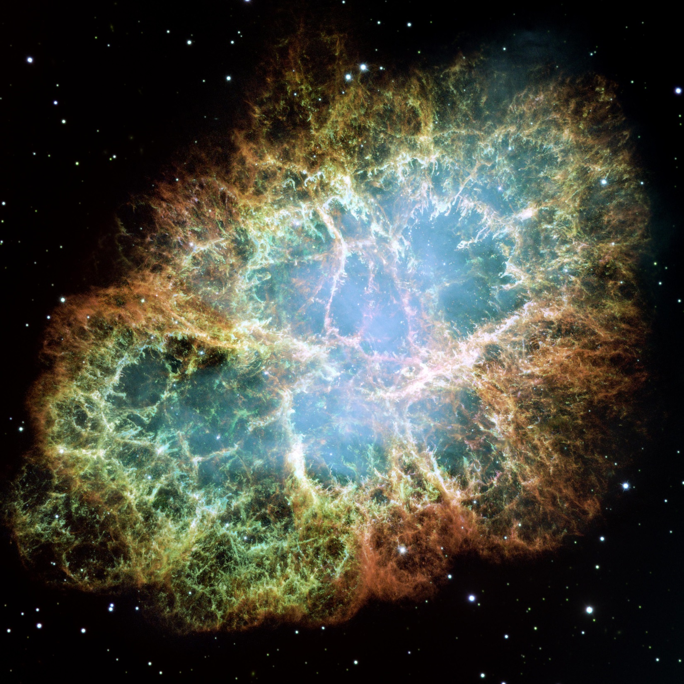
Notes:
When modern astronomers pointed their telescopes to this spot they discovered this: called the Crab Nebula, for its resemblance to a crab in smaller telescopes. It is an expanding remnant of an incredible explosion that occurred nearly a thousand years ago.
The core of a massive star ran out of fuel and could not fuse anything else and it collapsed into an amazingly dense state in a split second. That collapse sent a shockwave through the star’s outer layers that blasted it apart. During that explosion, heavy elements like gold and uranium were forged and spewed out into space. The Crab nebula is what is left of that still expanding blast wave.
Image Credit: NASA/STScI/HST

Slide 27
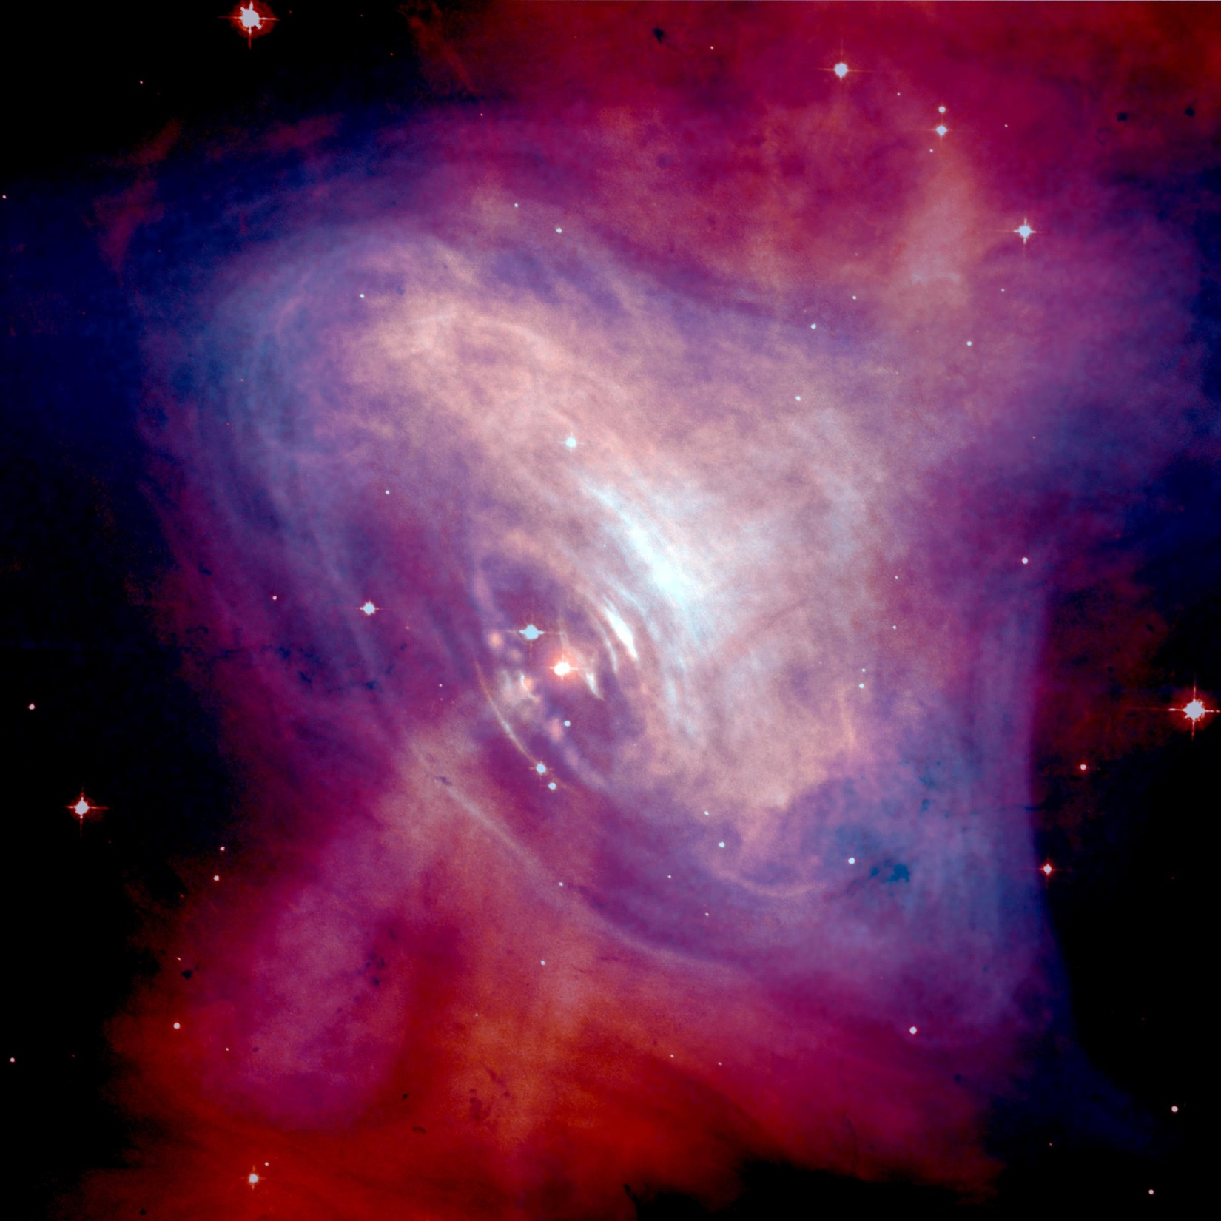
Notes:
At the center of the crab nebula is also the remnant of the core of the original star that exploded. It is an object so compact and dense that it is made out of nothing but neutrons packed as tightly together as neutrons are inside an atomic nucleus. It contains the equivalent of the mass of the Sun compacted into on object the size of a city: a neutron star. One spoonful of neutron star material would weigh as much as a mountain. This neutron star rotates very fast, several times per second and has a very strong magnetic field. The field moves charges particles around so fast that it generates beams of electromagnetic radiation at its poles that sweep around with the rotating star like a cosmic lighthouse. We call such a stellar remnant a pulsar, because we see those beams of sweeping radiation as steady and rapid pulses from the star.
Image Credit: NASA/Harvard-CfA/Chandra

Slide 28
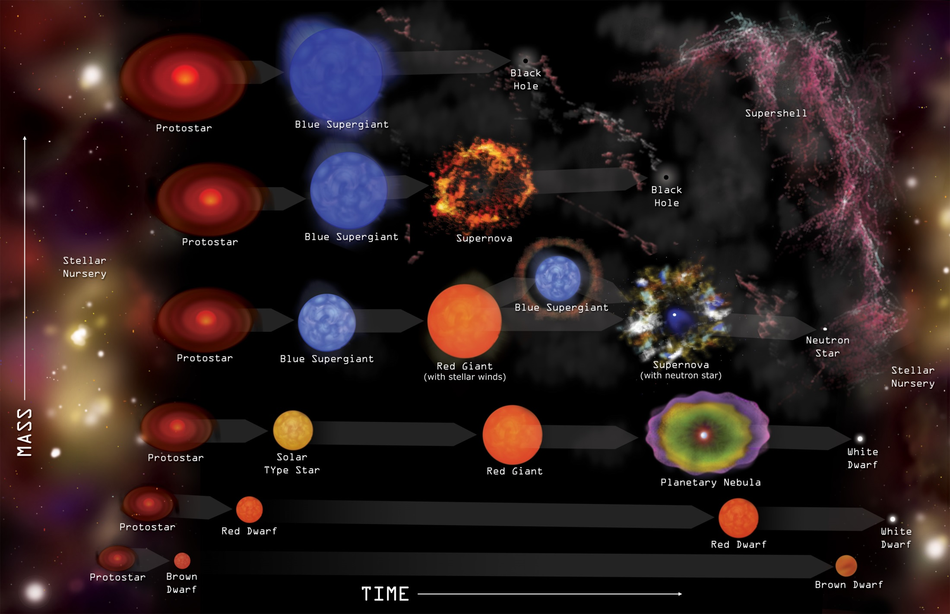
Notes:
The other remnant of a star’s death is new life. The shock wave from a supernova can compress gas in neighboring nebulae and set off new waves of star formation. The elements in the supernova remnant like hydrogen, carbon, silicon, oxygen, nitrogen, and iron are critical for making rocky planets that can have organic chemistry and possibly life.
That is exactly what we think. The iron in your blood, the oxygen in the air, all were forged in long-dead stars. As the Navajo say, the stars are our ancient relations.
Image Credit: NASA/Harvard-CfA/Chandra

